Slide 1
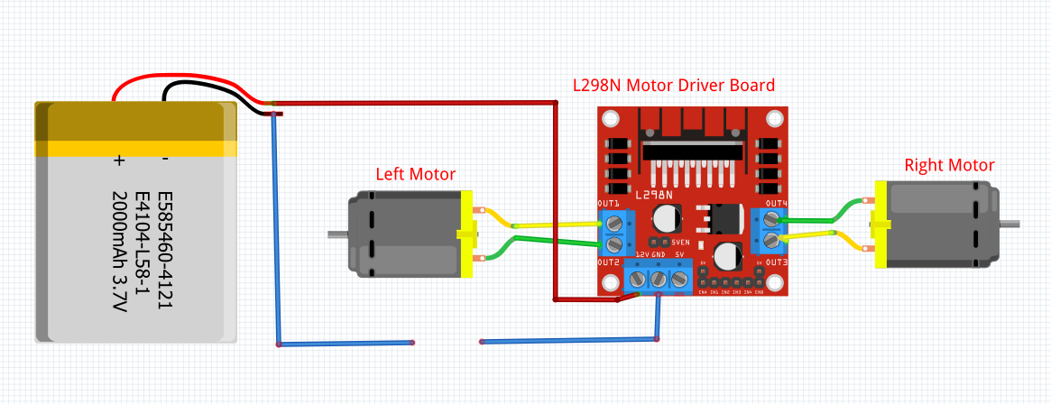
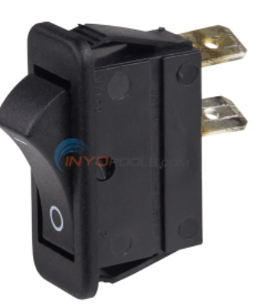

Slide 2
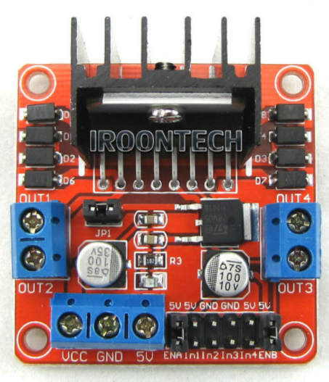
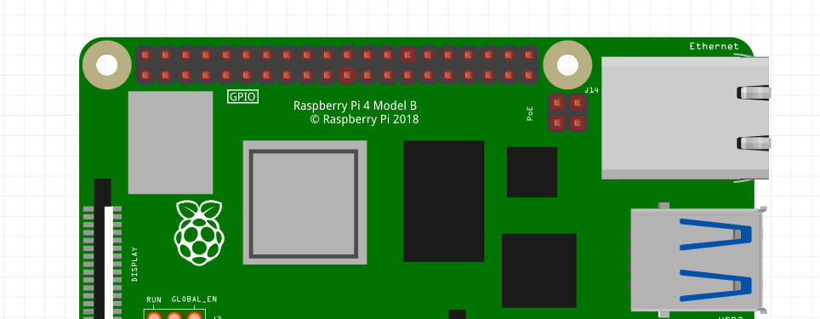
IN1 | GPIO 19
IN2 | GPIO 26
IN3 | GPIO 20
IN4 | GPIO 21
20
21
19
26

Slide 3
#save this program as testrobot.py
#Library
from gpiozero import Robot
from time import sleep
#Setup
robot = Robot(left=(19,26), right=(20,21))
#Algorithm
robot.forward(.9)
sleep(2)
robot.left(.9)
sleep(.2)
robot.forward(.8)
sleep(2)
robot.right(.9)
sleep(1)
robot.backward(.9)
sleep(2)
robot.stop()

Slide 4
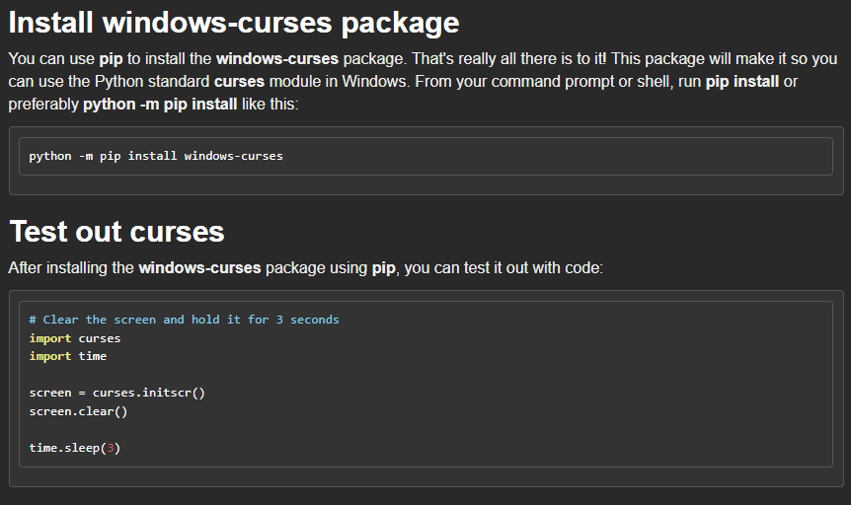

Slide 5
VirusGenerator
VGAquarius090317

